Slide 1
In Which Country will you invest ?
Basile Nguyen
Case study for ESG Data SCIENTIST
29.09.2021

Slide 2
ESG Sovereign RATING Model
Country Risk premium
Write a loader from the Worldbank database
Construct an ESG score
Select key indicators from the Worldbank and other sources
Aggregate the indicators into a meaningful score
Train models to predict the spread of sovereign bonds
Evaluate the performance of the models

Slide 3
ESG DATA STRUCTURE
Worldbank
CAIT
NGOs
Python Loader
CSV files
SQL Database
ESG Scores

Slide 4
Data acquisition and cleaning
Data from Worldbank (python loader) or NGOs (csv files)
Unique identifier: three-letter code
Filter by countries
Created a mapping and ignore lists (e.g remove regions)
Creation of scores
Normalize score between 0 (worst) to 100 (best)
e.g GHG emissions score (tCO2e)
Convert into intensity (tCO2e per GDP per capita PPP (MUSD)
Create a score based on intensity compared to median of the universe

Slide 5
ESG RATING MODEL

Slide 6
Model CONSTRUCTION : ESG Sovereign rating
ESG Score is an average of the E, S, G Pillars
Country must have at least 20% of coverage
ESG Country Score
1/3
1/3
1/3
6 indicators
5 indicators
8 indicators
E
S
G

Slide 7
Environment
6 indicators
Impact metrics
CAIT: GHG Emissions intensity
Annual freshwater withdrawals intensity
Energy intensity level of primary energy
% Renewable electricity
Forward-looking metrics (climate change adaptation*)
Germanwatch Global Climate Risk Index (Physical Risk)
ND-GAIN based country score
Vulnerability to effects of climate change
Readiness to adapt to climate change
* EU Taxonomy : one of six environmental objectives

Slide 8
Social
5 indicators
Impact metrics (performance relative to universe):
Income inequality – Gini index *
Human Capital Index
Poverty (7 data points based on % of population deprived)
Additional metrics from NGOs
RSF World Press Freedom Index *
Fund for peace – Fragile States Index (Human Rights and Rule of Law) *
* SFDR: related to adverse sustainability indicators from Table II

Slide 9
Governance
8 indicators
Worldwide Governance Indicators (WGI) project
Voice and Accountability
Political Stability and Absence of Violence/Terrorism *
Government Effectiveness
Regulatory Quality
Rule of Law *
Control of Corruption *
Ease of doing business score
Statistical capacity score
* SFDR: related to adverse sustainability indicators from Table II

Slide 10
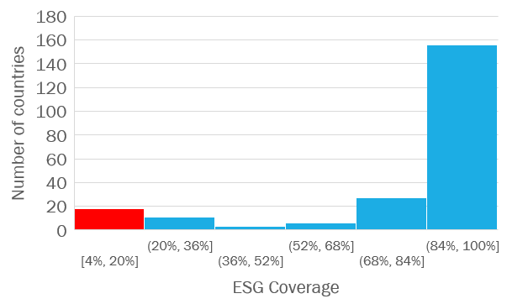
ESG COVERAGE
Remove score of countries with less than 20% of coverage

Slide 11
Adjust ESG RATING by GDP PPP
Developed countries tend to have higher ESG scores
ESG Adjusted Score
2 x ESG score – linear trend (GDP PPP)

Slide 12
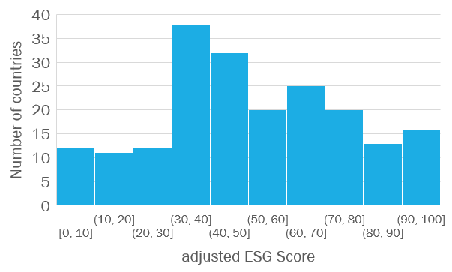
ADJUSTED ESG SCORE DISTRIBUTION
Average | 50.8
Median | 48.1
Std | 25.3
Min | 0.0
Max | 100.0

Slide 13
ESG LEADERS AND LAGGARDS
ESG LEADERS
AVERAGE ESG
ESG LAGGARDS
Austria
Denmark
Finland
Norway
Switzerland
Senegal
Oman
Paraguay
Maldives
Uganda
Eritrea
Libya
Turkmenistan
Venezuela
Yemen

Slide 14
ADJUSTED ESG SCORE PER REGIOn

Slide 15
Next steps :
Improve rating scheme :
Group countries by universe (e.g Europe-North America versus Emerging). Adjust weights depending their universe
Bonus/malus depending on trend of scores
Controversies ?
Improve Environment pillar:
Eu Taxonomy: Climate change mitigation, climate change adaptation, circular economy, pollution prevention, biodiversity.
Improve Social pillar:
Inclusiveness (e,g gender equality), health and life expectancy

Slide 16
Country Risk premium

Slide 17
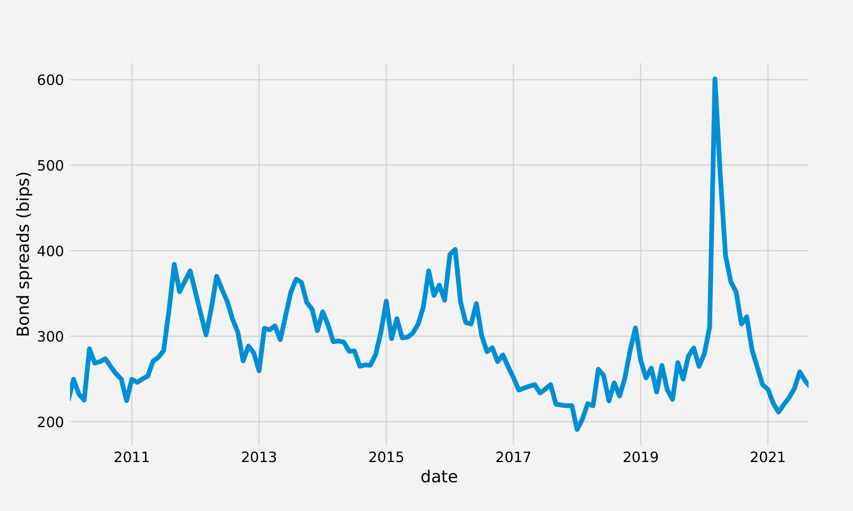
Case-study : CHILE

Slide 18
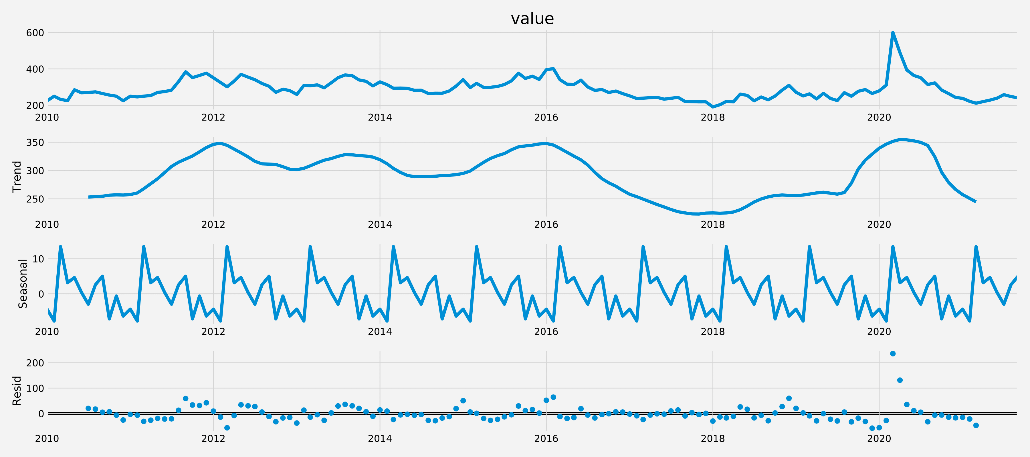
Case study : CHILE

Slide 19
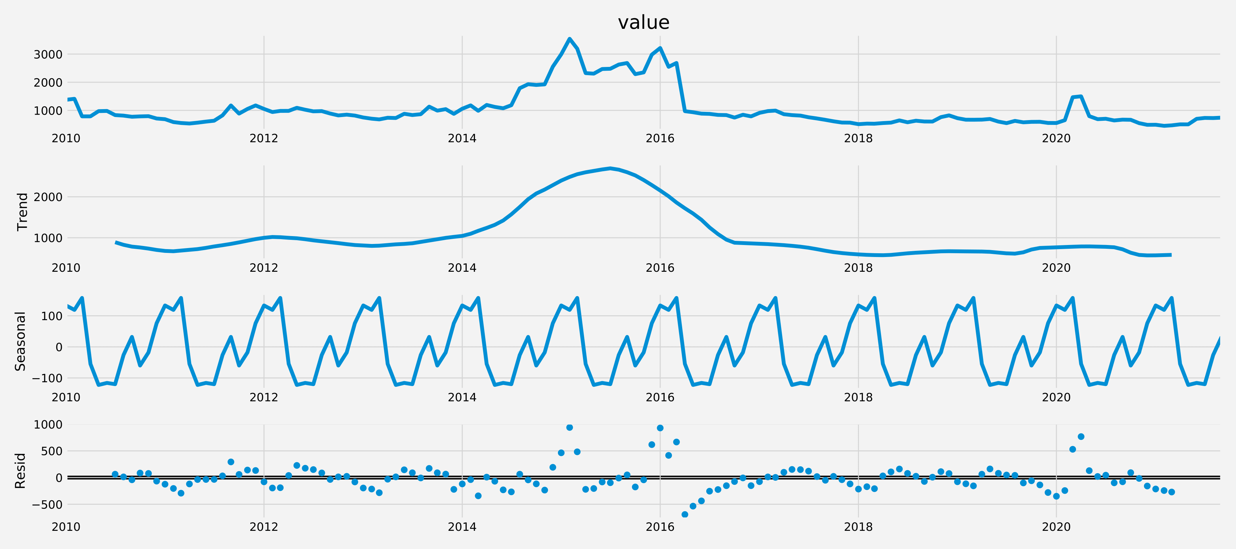
Case study : Ukraine

Slide 20
Models for time-series prediction
Prophet from Facebook (2018)
SARIMA Models
Recurrent neural networks and LSTMs

Slide 21
Prophet (facebook 2018)
Robust procedure based on additive model and focused on three features :
Trend, Seasonality, holiday effects
Requires several seasons of historical data
Accurate, fast, fully automatic (robust)

Slide 22
PropHet prediction : Chile

Slide 23
How to evaluate performance: cross-validation
Time
Data
Train
Test
Train
Test
Train
Test

Slide 24
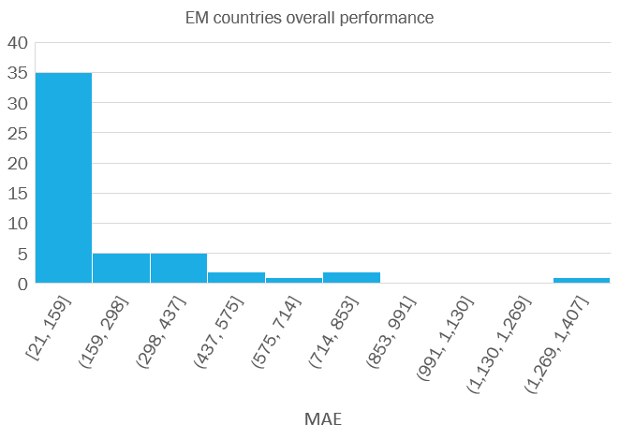
Prohpet PRELIMINARY Results
Good fit: Chile
Average MAE : 95 bips
Average RMSE :67 bips
Bad fit: Ukraine
Average MAE : 747 bips
Average RMSE : 599 bips

Slide 25
Next steps :
Finish exploration of SARIMA models
More complex to tune but may yield better results in some cases
LSTMs
Can model multivariate sequences
Difficult to tune and need large amount of data to be efficient
Exepection : better reults for long term modelling

Slide 26
HIGHER ESG SCORES are ASSOCIATED WITH LOWER SPREADS

Slide 27
Conclusion

Slide 28
EXTRA ESG Slides

Slide 29
EU TAXONOMY : six environnemental objectives
climate change mitigation
climate change adaptation
sustainable use and protection of water and marine resources
transition to a circular economy
pollution prevention and control
protection and restoration of biodiversity and ecosystems.

Slide 30
SFDR : OPT-in Principale adverse indicators for sovereign
Social and Human Rights from Table II
18. Average income inequality score
19. Average freedom of expression score
20. Average human rights performance
Governance indicators from Table II
21. Average corruption score
22. (Non-cooperative tax jurisdictions)
23. Average political stability score
24. Average rule of law score

Slide 31
ESG LEADERS AND LAGGARDS (UNADJUSTED SCORE)
ESG LEADERS
AVERAGE ESG
ESG LAGGARDS
New Zealand
Finland
Iceland
Sweden
Norway
Thailand
Dominican Republic
Vanuatu
Botswana
Suriname
Libya
Eritrea
Curacao
Sint Maarten (Dutch part)
Turks and Caicos Islands

Slide 32
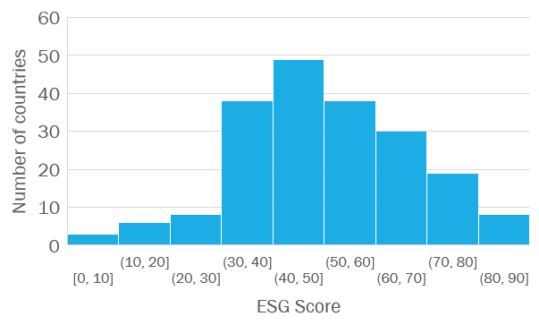
ESG SCORE DISTRIBUTION
Average | 50.0
Median | 49.3
Std | 17.0
Min | 0.0
Max | 89.6

Slide 33
ESG SCORE PER REGIOn

Slide 34
Spread Prediction

Slide 35
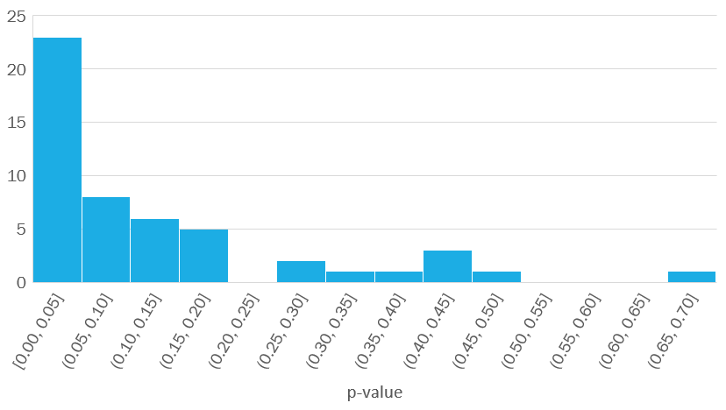
Augmented Dicker-Fuller Test (Stationarity)

Slide 36
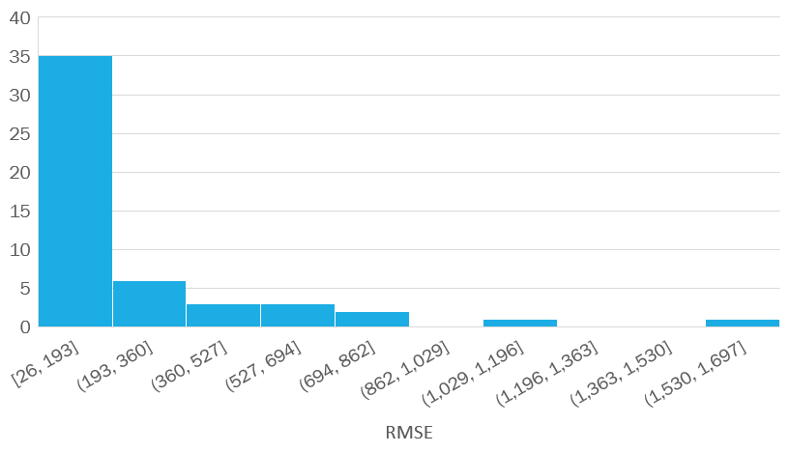
PROPHET RMSE

Slide 37
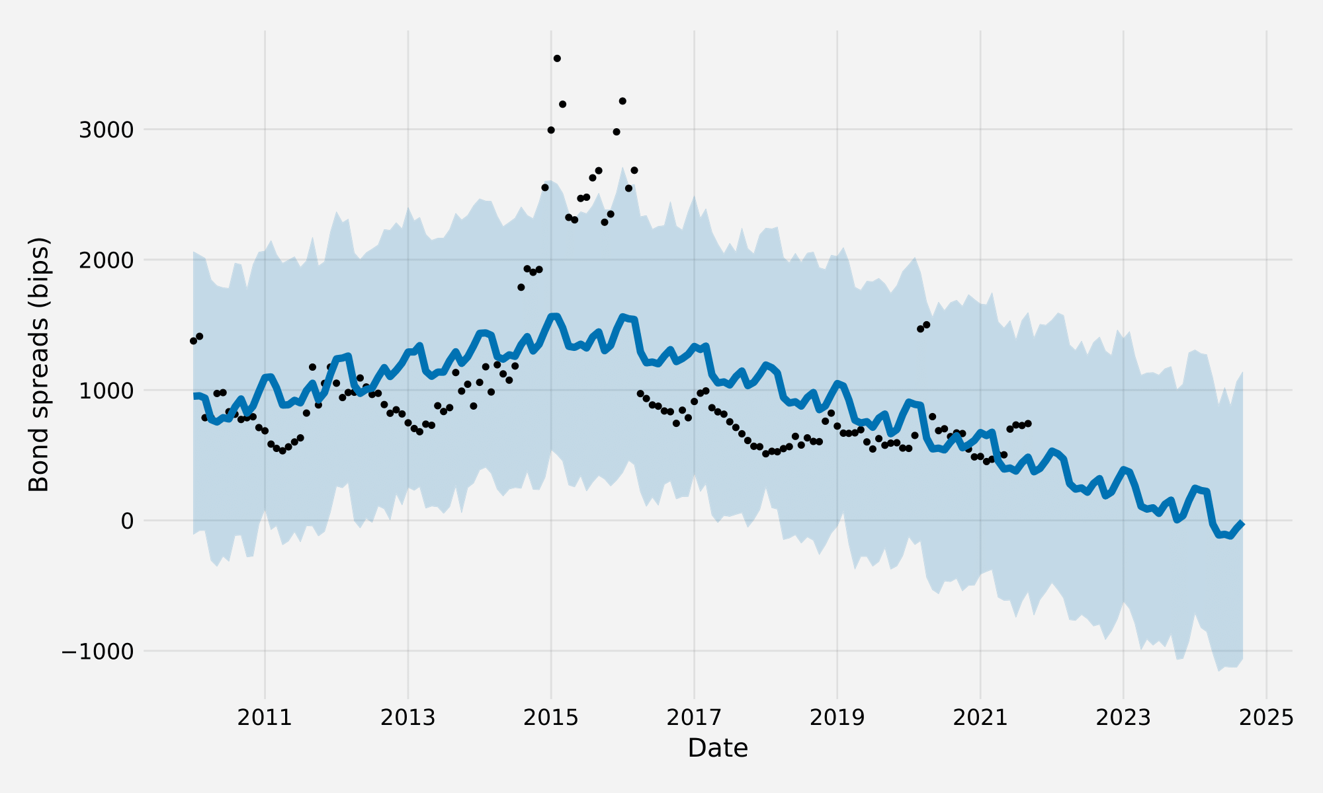
Prohpet Ukraine prediction

Slide 38
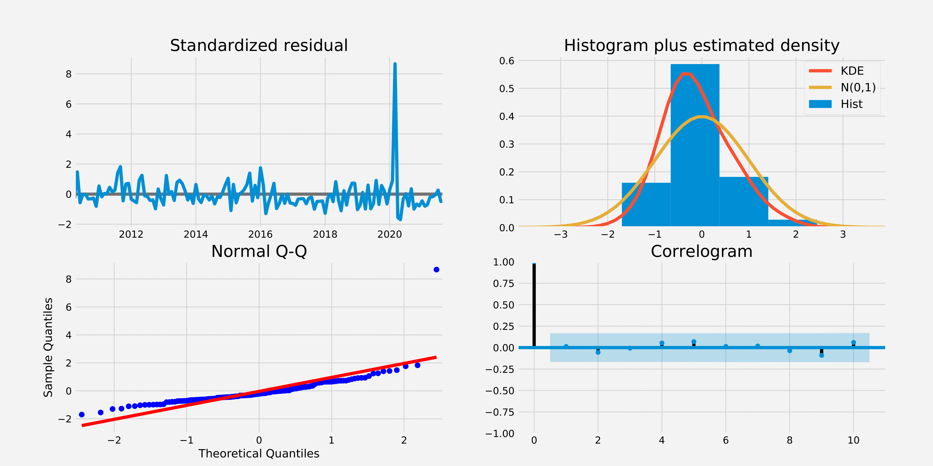
SARIMA: GOODNESS OF FIT FOR CHILE

Slide 39
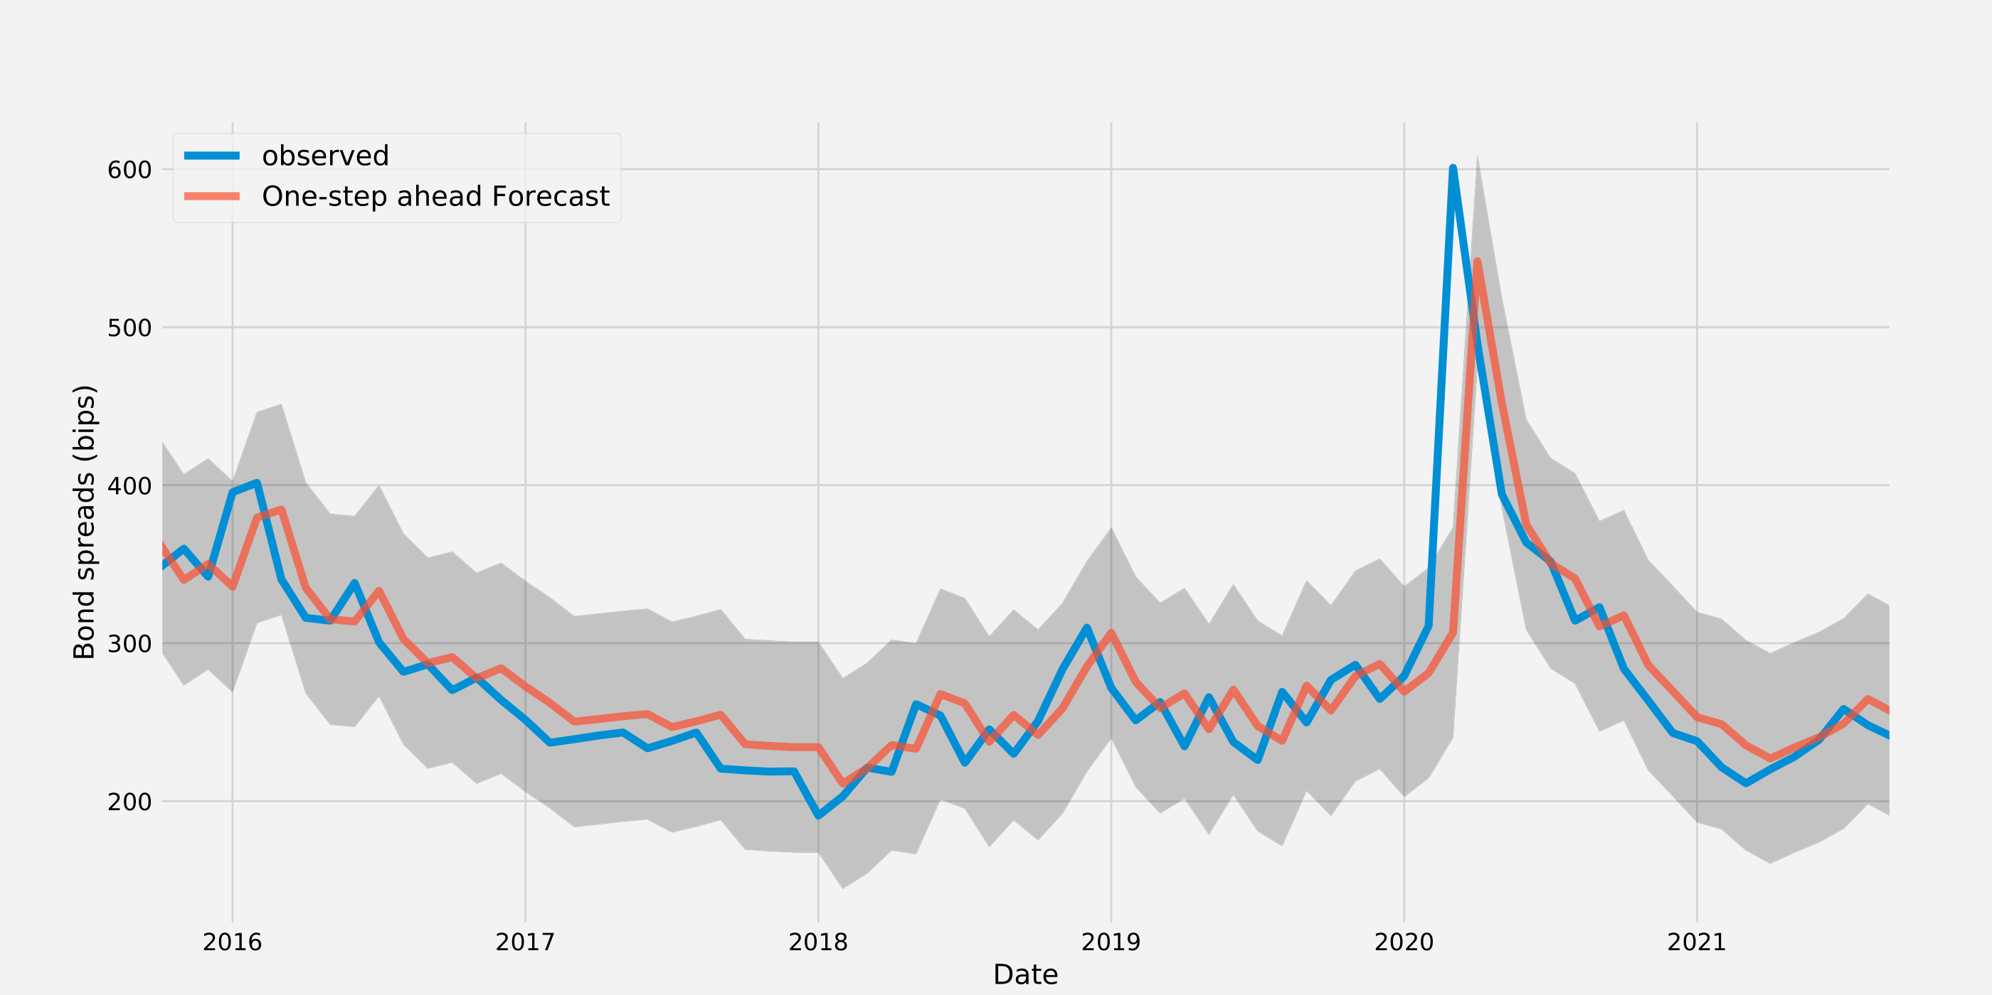
SARIMA: GOODNESS OF FIT FOR CHILE

